Slide 1
CEN 522: Topic 8 I/O
By Mr O. Omoruyi

Slide 2
Input and Output
The input/output or I/O section allows the computer to take in data from the outside world. Peripherals such as keyboards, video display terminals, printers, Disk drive controller and modems are connected to the I/O section.
The actual physical devices used to interface the computer buses to external systems are often called ports. An input port allows data from a keyboard, an A/D converter, or some other source to be read into the computer under control of the CPU. An output port is used to send data from the computer to some peripheral, such as a video display terminal/ Screen, a printer, or a D/A converter.

Slide 3
Input and Output (cont’d)
Physically, the simplest type of input or output port is just a set of parallel D flip-flops. If they are being used as an input port, the D inputs are connected to the external device, and the Q outputs are connected to the data bus which runs to the CPU. Data will then be transferred through the latches when they are enabled by a control signal from the CPU.
In a system where they are being used as an output port, the D inputs of the latches are connected to the data bus, and the Q outputs are connected to some external device. Data sent out on the data bus by the CPU will be transferred to the external device when the latches are enabled by a control signal from the CPU.

Slide 4
I/O Ports
I/O devices are connected to the computer through I/O circuits. Each of these circuits contains several register called I/O Ports. Some are used for data while others are used control commands. Like memory locations, the I/O ports have address and they are connected to the bus system. These addresses are known as I/O address and can only be use in input (IN) or output (OUT) instructions.

Slide 5
Input/Output Problems
Wide variety of peripherals
Delivering different amounts of data
At different speeds
In different formats
All slower than CPU and RAM
Need I/O modules

Slide 6
Input/Output Module
Interface to CPU and Memory
Interface to one or more peripherals

Slide 7
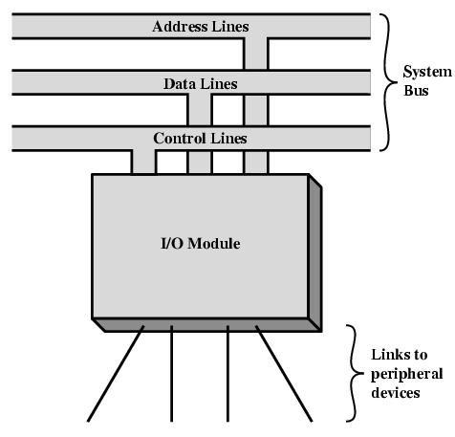
Generic Model of I/O Module

Slide 8
External Devices
Human readable
Screen, printer, keyboard
Machine readable
Monitoring and control
Communication
Modem
Network Interface Card (NIC)

Slide 9
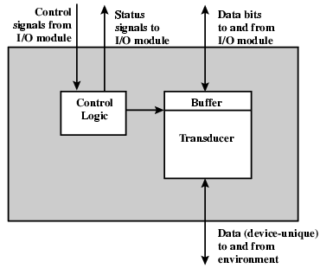
External Device Block Diagram

Slide 10
I/O Module Function
Control & Timing
CPU Communication
Device Communication
Data Buffering
Error Detection

Slide 11
I/O Steps
CPU checks I/O module device status
I/O module returns status
If ready, CPU requests data transfer
I/O module gets data from device
I/O module transfers data to CPU
Variations for output, DMA, etc.

Slide 12
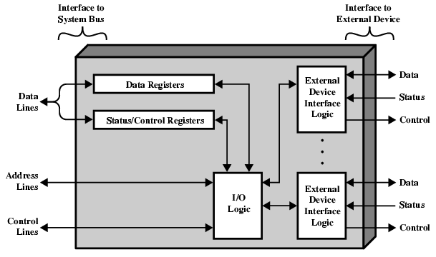
I/O Module Diagram

Slide 13
I/O Module Decisions
Hide or reveal device properties to CPU
Support multiple or single device
Control device functions or leave for CPU
Also O/S decisions
e.g. Unix treats everything it can as a file

Slide 14
Input Output Techniques
Programmed
Interrupt driven
Direct Memory Access (DMA)

Slide 15
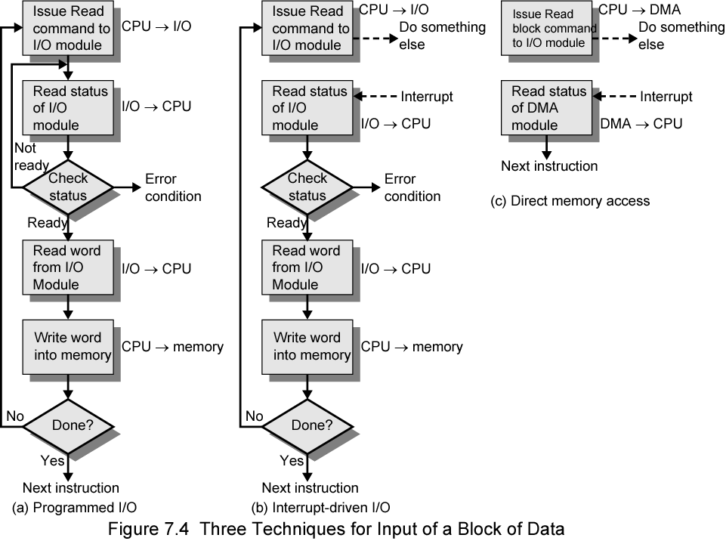
Three Techniques for Input of a Block of Data

Slide 16
Programmed I/O
CPU has direct control over I/O
Sensing status
Read/write commands
Transferring data
CPU waits for I/O module to complete operation
Wastes CPU time

Slide 17
Programmed I/O - detail
CPU requests I/O operation
I/O module performs operation
I/O module sets status bits
CPU checks status bits periodically
I/O module does not inform CPU directly
I/O module does not interrupt CPU
CPU may wait or come back later

Slide 18
I/O Commands
CPU issues address
Identifies module (& device if >1 per module)
CPU issues command
Control - telling module what to do
e.g. spin up disk
Test - check status
e.g. power? Error?
Read/Write
Module transfers data via buffer from/to device

Slide 19
Addressing I/O Devices
Under programmed I/O data transfer is very like memory access
Each device given unique identifier
CPU commands contain identifier (address)

Slide 20
I/O Mapping
Memory mapped I/O
Devices and memory share an address space
I/O looks just like memory read/write
No special commands for I/O
Large selection of memory access commands available
Isolated I/O
Separate address spaces
Need I/O or memory select lines
Special commands for I/O
Limited set

Slide 21
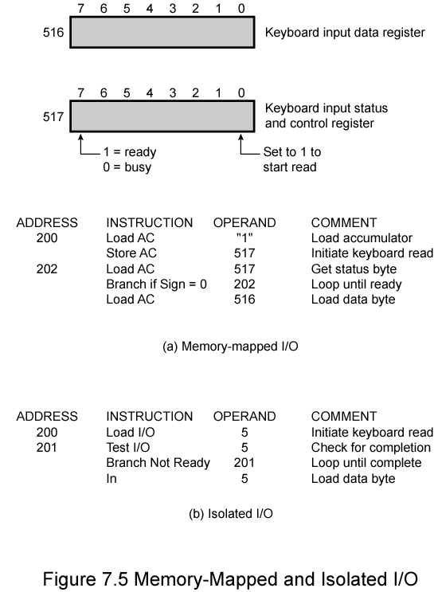
Memory Mapped and Isolated I/O

Slide 22
Interrupt Driven I/O
Overcomes CPU waiting
No repeated CPU checking of device
I/O module interrupts when ready

Slide 23
Interrupt Driven I/O Basic Operation
CPU issues read command
I/O module gets data from peripheral whilst CPU does other work
I/O module interrupts CPU
CPU requests data
I/O module transfers data

Slide 24
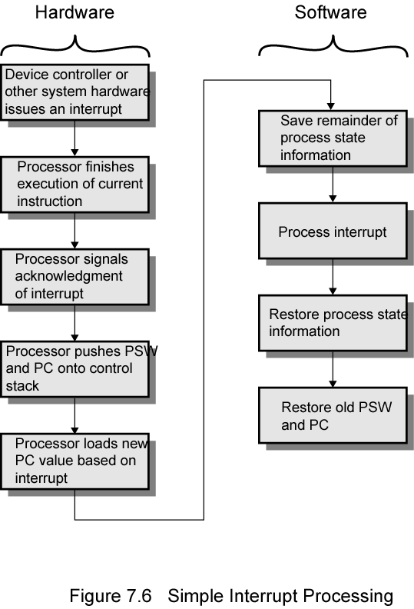
Simple Interrupt Processing

Slide 25
CPU Viewpoint
Issue read command
Do other work
Check for interrupt at end of each instruction cycle
If interrupted:-
Save context (registers)
Process interrupt
Fetch data & store

Slide 26
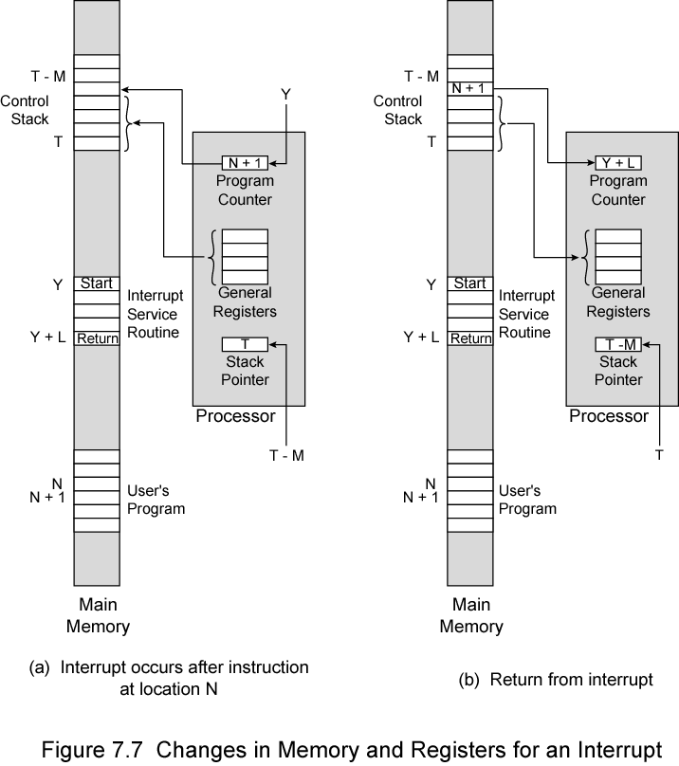
Changes in Memory and Registers for an Interrupt

Slide 27
Design Issues
How do you identify the module issuing the interrupt?
How do you deal with multiple interrupts?
i.e. an interrupt handler being interrupted

Slide 28
Identifying Interrupting Module (1)
Different line for each module
PC
Limits number of devices
Software poll
CPU asks each module in turn
Slow

Slide 29
Identifying Interrupting Module (2)
Daisy Chain or Hardware poll
Interrupt Acknowledge sent down a chain
Module responsible places vector on bus
CPU uses vector to identify handler routine
Bus Master
Module must claim the bus before it can raise interrupt
e.g. PCI & SCSI

Slide 30
Multiple Interrupts
Each interrupt line has a priority
Higher priority lines can interrupt lower priority lines
If bus mastering only current master can interrupt

Slide 31
Example - PC Bus
80x86 has one interrupt line
8086 based systems use one 8259A interrupt controller
8259A has 8 interrupt lines

Slide 32
Sequence of Events
8259A accepts interrupts
8259A determines priority
8259A signals 8086 (raises INTR line)
CPU Acknowledges
8259A puts correct vector on data bus
CPU processes interrupt

Slide 33
ISA Bus Interrupt System
ISA bus chains two 8259As together
Link is via interrupt 2
Gives 15 lines
16 lines less one for link
IRQ 9 is used to re-route anything trying to use IRQ 2
Backwards compatibility
Incorporated in chip set

Slide 34
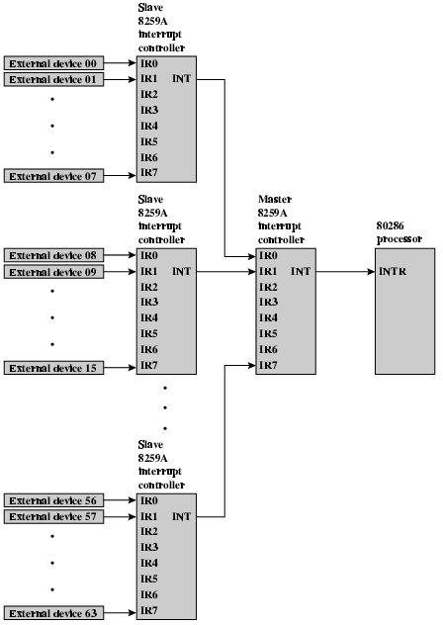
82C59A Interrupt Controller

Slide 35
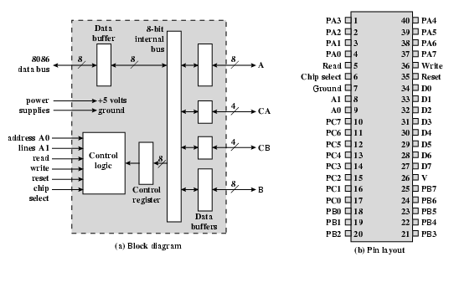
Intel 82C55A Programmable Peripheral Interface

Slide 36
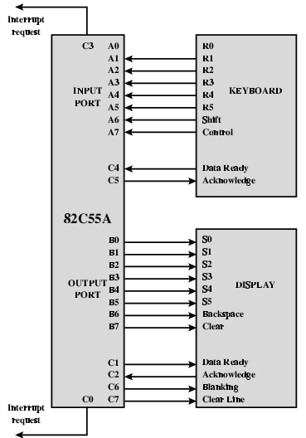
Keyboard/Display Interfaces to 82C55A

Slide 37
Direct Memory Access
Interrupt driven and programmed I/O require active CPU intervention
Transfer rate is limited
CPU is tied up
DMA is the answer

Slide 38
DMA Function
Additional Module (hardware) on bus
DMA controller takes over from CPU for I/O

Slide 39
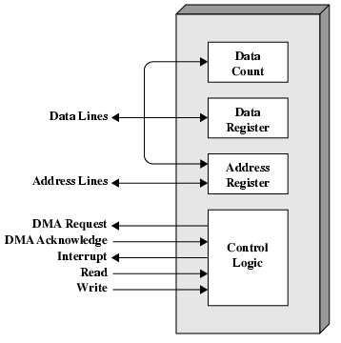
Typical DMA Module Diagram

Slide 40
DMA Operation
CPU tells DMA controller:-
Read/Write
Device address
Starting address of memory block for data
Amount of data to be transferred
CPU carries on with other work
DMA controller deals with transfer
DMA controller sends interrupt when finished

Slide 41
DMA Transfer Cycle Stealing
DMA controller takes over bus for a cycle
Transfer of one word of data
Not an interrupt
CPU does not switch context
CPU suspended just before it accesses bus
i.e. before an operand or data fetch or a data write
Slows down CPU but not as much as CPU doing transfer

Slide 42
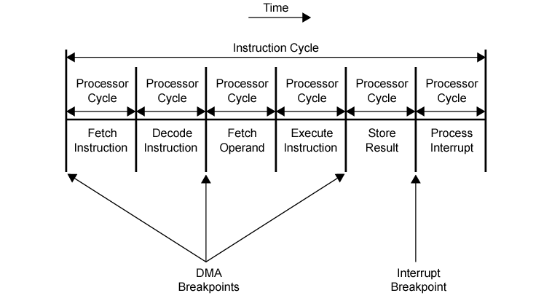
DMA and Interrupt Breakpoints During an Instruction Cycle

Slide 43
Aside
What effect does caching memory have on DMA?
What about on board cache?
Hint: how much are the system buses available?

Slide 44
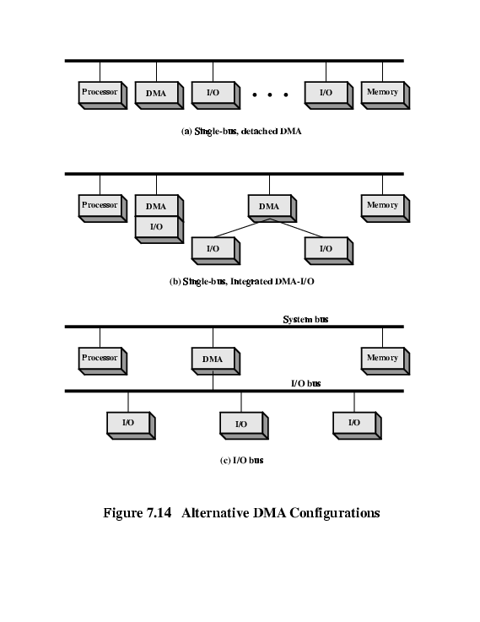
DMA Configurations (1)
Single Bus, Detached DMA controller
Each transfer uses bus twice
I/O to DMA then DMA to memory
CPU is suspended twice

Slide 45
DMA Configurations (2)
Single Bus, Integrated DMA controller
Controller may support >1 device
Each transfer uses bus once
DMA to memory
CPU is suspended once

Slide 46
DMA Configurations (3)
Separate I/O Bus
Bus supports all DMA enabled devices
Each transfer uses bus once
DMA to memory
CPU is suspended once

Slide 47
Intel 8237A DMA Controller
Interfaces to 80x86 family and DRAM
When DMA module needs buses it sends HOLD signal to processor
CPU responds HLDA (hold acknowledge)
DMA module can use buses
E.g. transfer data from memory to disk
Device requests service of DMA by pulling DREQ (DMA request) high
DMA puts high on HRQ (hold request),
CPU finishes present bus cycle (not necessarily present instruction) and puts high on HDLA (hold acknowledge). HOLD remains active for duration of DMA
DMA activates DACK (DMA acknowledge), telling device to start transfer
DMA starts transfer by putting address of first byte on address bus and activating MEMR; it then activates IOW to write to peripheral. DMA decrements counter and increments address pointer. Repeat until count reaches zero
DMA deactivates HRQ, giving bus back to CPU

Slide 48
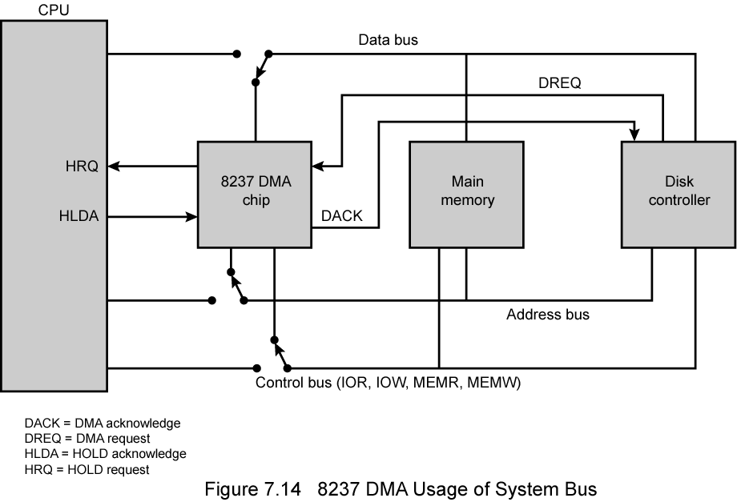
8237 DMA Usage of Systems Bus

Slide 49
Fly-By
While DMA using buses processor idle
Processor using bus, DMA idle
Known as fly-by DMA controller
Data does not pass through and is not stored in DMA chip
DMA only between I/O port and memory
Not between two I/O ports or two memory locations
Can do memory to memory via register
8237 contains four DMA channels
Programmed independently
Any one active
Numbered 0, 1, 2, and 3

Slide 50
I/O Channels
I/O devices getting more sophisticated
e.g. 3D graphics cards
CPU instructs I/O controller to do transfer
I/O controller does entire transfer
Improves speed
Takes load off CPU
Dedicated processor is faster

Slide 51
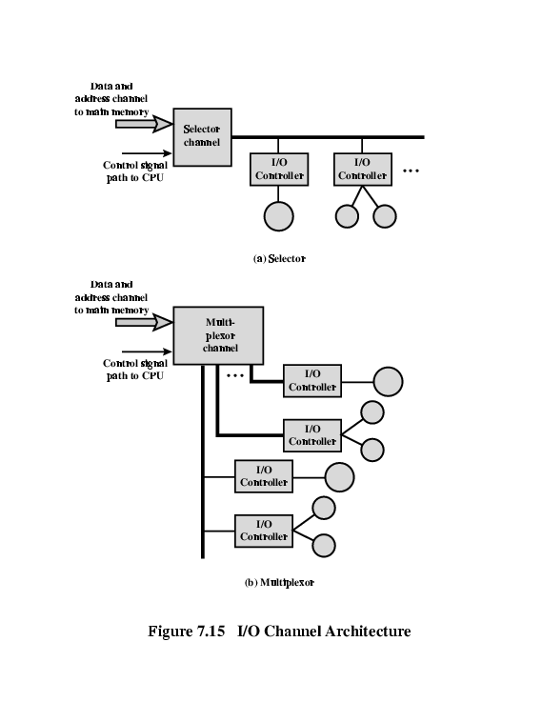
I/O Channel Architecture

Slide 52
Interfacing
Connecting devices together
Bit of wire?
Dedicated processor/memory/buses?
E.g. FireWire, InfiniBand

Slide 53
Conclusion
Thank you.
References
Apeh, S. Lecture notes on Advanced Microcomputer systems, 2015

